Slide 1


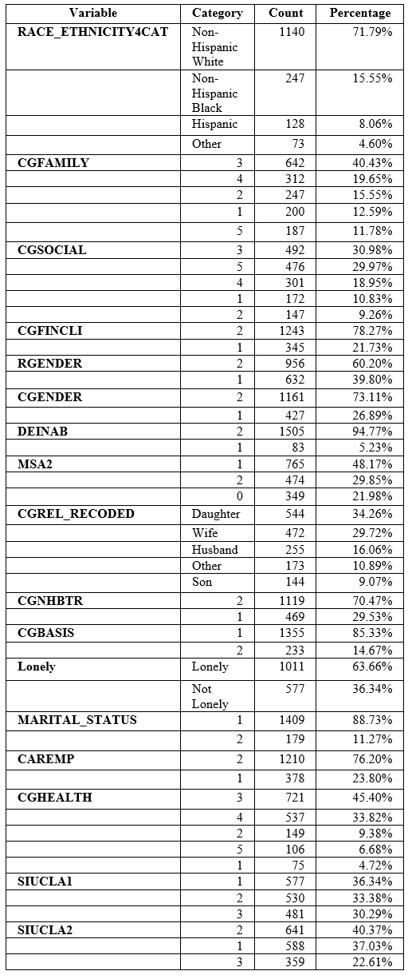
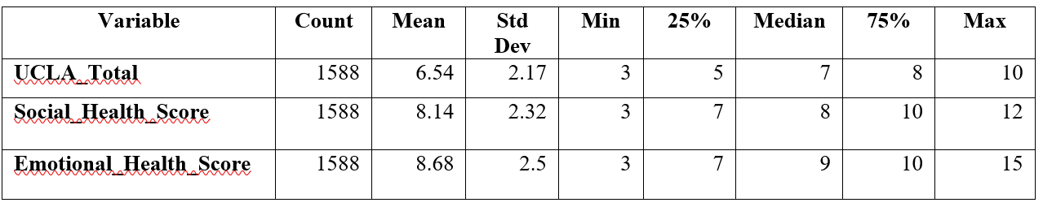
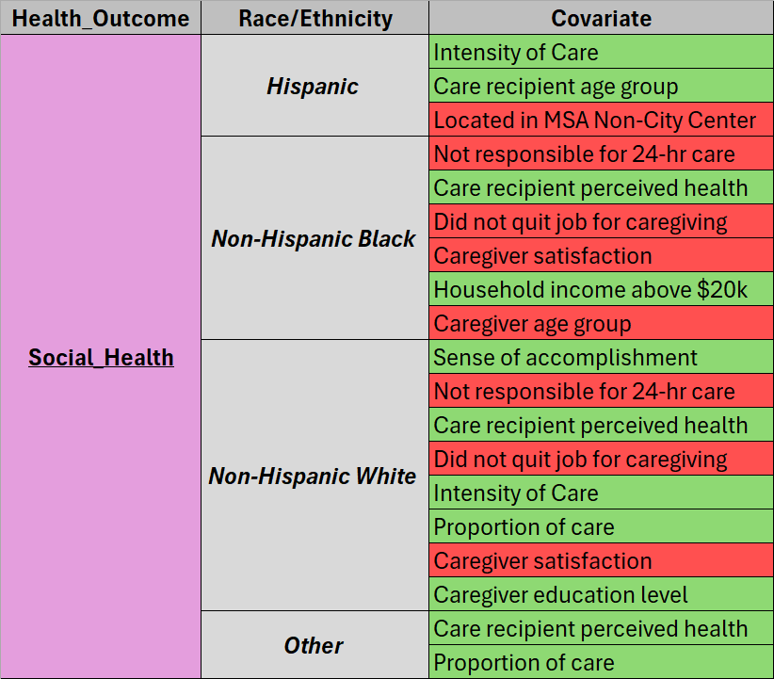
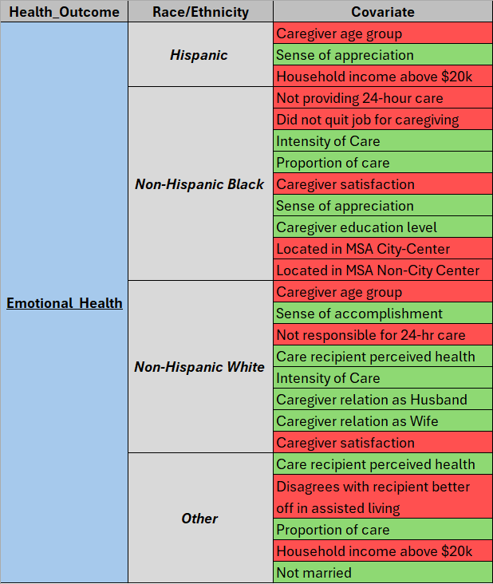
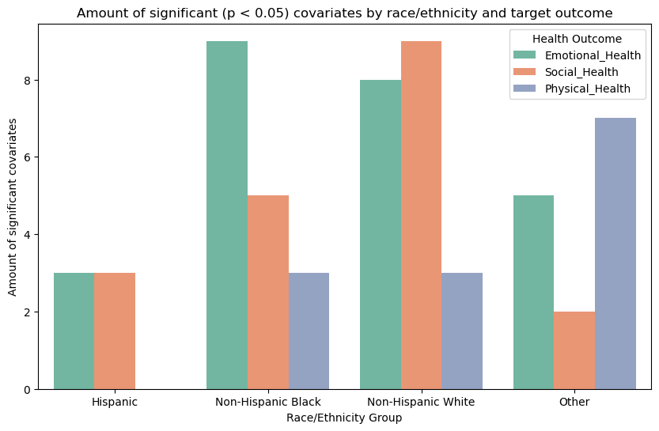
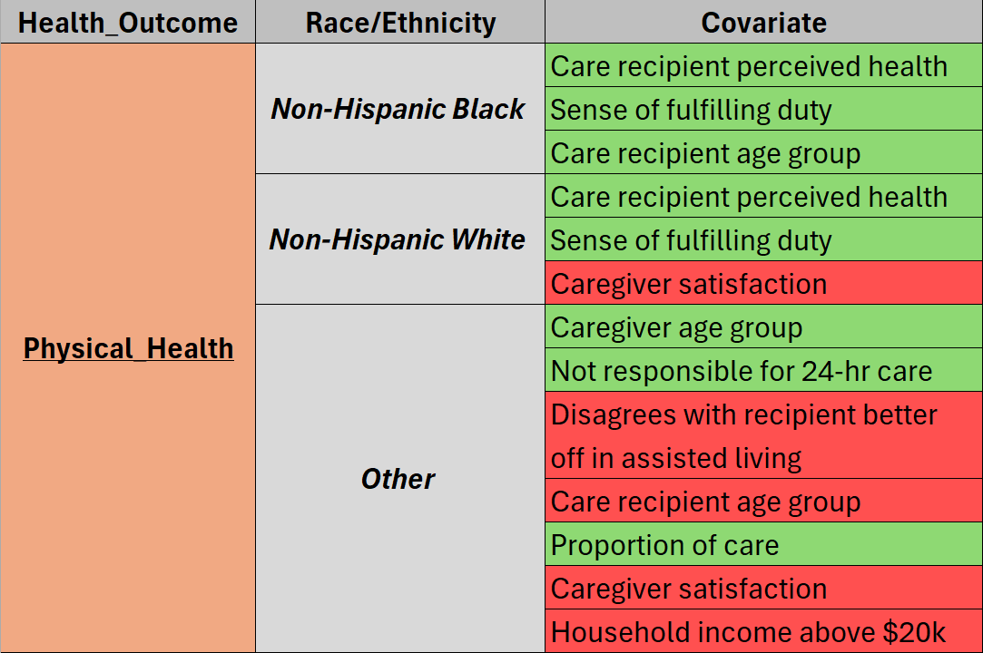
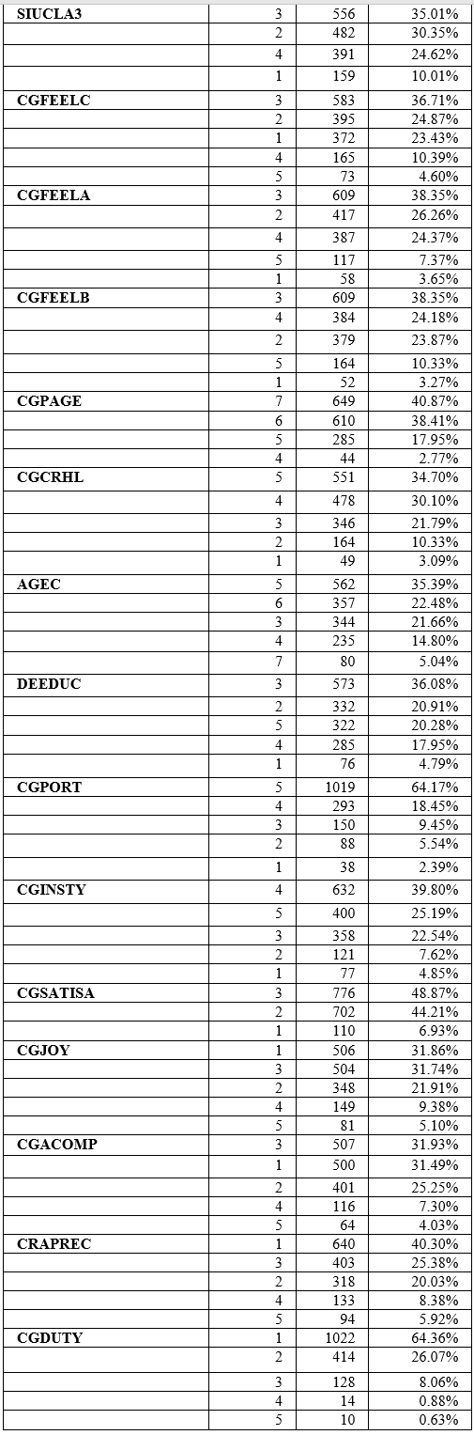
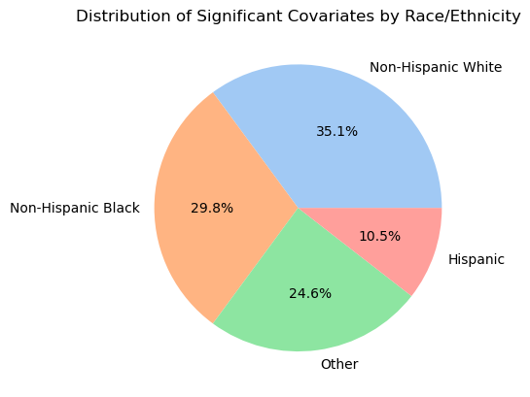
CAREGIVING FOR INDIVIDUALS WITH DEMENTIA:
RACIAL AND ETHNIC DIFFERENCES IN CAREGIVER HEALTH OUTCOMES
MOHAMMADREZA MOSLEHIKHAH, CONNOR SOTELO, PRABHU CHAITANYA MOLABANTI, AKHIL THANGALLAPELLI
Department of Health & Clinical Outcomes Research
Saint Louis University, St. Louis, Missouri
Background
Table 1 Categorical and Continuous Variable Descriptive Statistics
Categorical Variables Continuous Variables
Results
In 2024, nearly 7 million Americans are living with Alzheimer’s disease, affecting over 10.9% of the population aged 65 and older¹. By 2050, the number of people affected by this disease in the US is expected to grow to nearly 13 million¹.
The impact of dementia extends beyond those affected, deeply influencing primary caregivers. These caregivers assist with daily activities, from basic self-care to complex tasks like financial management and community involvement ².
Caregiving for individuals with dementia is linked to significant emotional and physical stress. Research shows that caregiver health is crucial for their own sustainability and quality of life³.
Previous care models for dementia patients focus more with biopsychosocial principles of the patient and caregiver, but often do not consider the family system and existing social relationships as factors or determinants⁴.
Existing literature on the health of dementia caregivers often overlooks the role of racial and ethnic minority identity.
Goals of study
To predict the differences in emotional, physical, and social health outcomes of caregivers based on their self-described race/ethnicity.
To identify the differential factors that contribute to care-partner health compared to those who self-identify as non-hispanic white.
An ordered logistic regression study revealed unique predictors impacting the three health outcomes among the 4 categories of race/ethnicity. Several covariate predictors never showed any significance like caregiver gender or caregiver joy.
Positive association = GREEN, Negative association = RED
Methods
I. Data Source and Sampling
National Survey of Older Americans Act Participants (NSOAAP) - Conducted by Administration on Aging (AoA) Administration for Community Living (ACL)
Caregivers datasets from 2021–2022
Cross-sectional survey data collected from caregivers of individuals with dementia.
Cohort was defined as being a care partner to a care recipient with diagnosed case of dementia. Selection of caregivers with available race/ethnicity data.
II. Measures and Outcomes
Outcomes: Physical, Emotional, Social health
Exposure variable: Self described race/ethnicity
Health related survey response covariates selected from the NSOAAP dataset.
III. Data Preparation
Combined 2021/2022 data; removed missing/duplicate data
Variable substitution for inconsistently recorded variables
Missingness correlation analysis on outcome variables
Feature engineering and variable composition
IV. Feature Understanding via Exploratory Data Analysis (EDA)
Variable examination and descriptive analysis
Distribution analysis for outcome variables and covariates
Creation of outcome variable scaling
Outcome distribution + covariate correlation
Covariate and outcome distribution analysis stratified by race/ethnicity
Covariate-outcome analysis with chi-squared test
V. Regression Modeling Analysis
Setup models with re-encoded variables
Applied ordered logistic regression on health outcomes.
Train/test split for model predictions and evaluation
Used BFGS optimizer
Physical, emotional, and social health stratified by race/ethnicity
Explored how covariates influenced the health outcomes within each group.
Figure 1. Count of Significant Covariates by Race/Ethnicity
Conclusion
The examination of social, mental, and physical health consequences reveals varying impacts on different racial/ethnic groups, ranked by the number of significant predictors for each group. Non-Hispanic Whites are the most afflicted, but compared to them it seems that non-Hispanic Blacks are comparable from the remaining race/ethnic groups. This study highlights significant disparities in the health outcomes of caregivers of individuals with dementia based on their race and ethnicity, emphasizing the critical need for culturally sensitive interventions. Strictly by numbers, from significant factors across all evaluations conducted, we count 32 influentially related factors for non-Hispanic Black caregivers, 41 for non-Hispanic White caregivers, 15 for Hispanic, and 14 for other non-Hispanic other caregivers totaling 102 observations of significant covariate influencers. Compared to non-Hispanic caregivers, non-Hispanic Black caregivers may be the most affected by dementia caregiving disparities.
Figure 2. Distribution of Significant Covariates by Race/Ethnicity
References: ¹Alzheimer’s disease facts and figures. Alzheimer’s Disease and Dementia. (2024). https://www.alz.org/alzheimers-dementia/facts-figures., ²Lin, C. Y., Shih, P. Y., & Ku, L. E. (2019). Activities of daily living function and neuropsychiatric symptoms of people with dementia and caregiver burden: The mediating role of caregiving hours. Archives of gerontology and geriatrics, 81, 25–30. https://doi.org/10.1016/j.archger.2018.11.009 ., ³Schulz, R., & Sherwood, P. R. (2008). Physical and mental health effects of family caregiving. The American journal of nursing, 108(9 Suppl), 23–27. https://doi.org/10.1097/01.NAJ.0000336406.45248.4c, ⁴Podgorski CA, Anderson SD, Parmar J. A Biopsychosocial-Ecological Framework for Family-Framed Dementia Care. Frontiers in psychiatry. 2021;12:744806. doi:10.3389/fpsyt.2021.744806,

